Slide 1
Deliverable 2
:

Slide 2
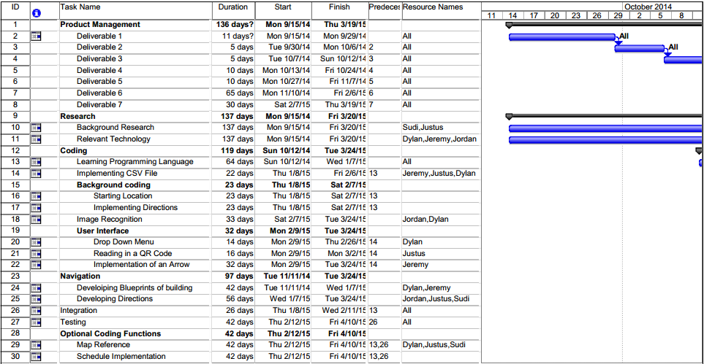
Gantt Chart

Slide 3
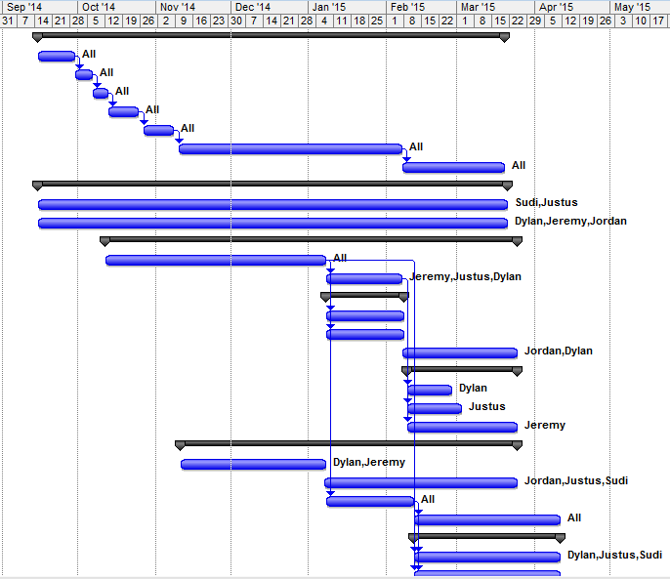
Gantt Chart

